Slide 1


MAKAAN.COM
RENTAL PROPERTIES PRICE PREDICTION MODEL
by Pranay Bangar

Slide 2

INTRODUCTION
Mumbai's rental market is complex and ever-changing. Predicting rental prices can help tenants and landlords make better decisions. This project aims to create a model to approximate rental prices in Mumbai, bringing more clarity and efficiency to the market.

Slide 3
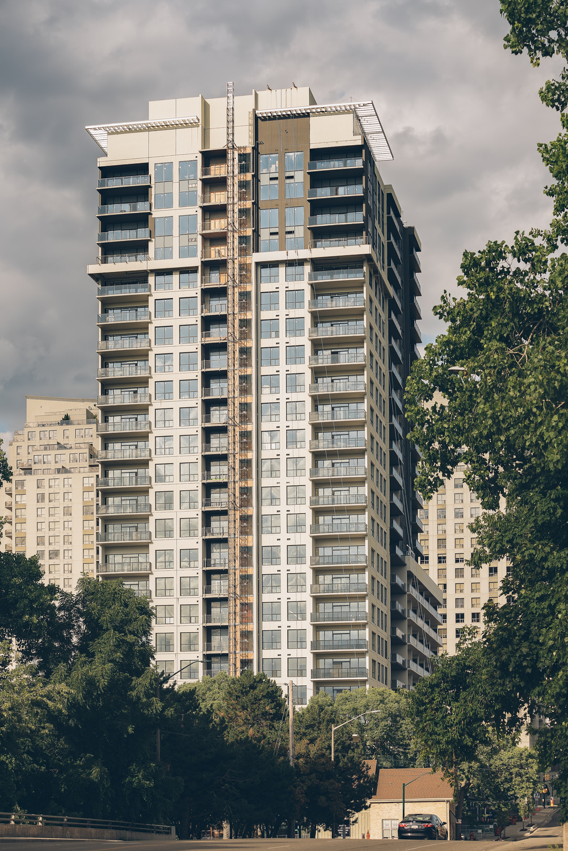
DATA COLLECTION
To gather data for this project,I used the Beautiful Soup library to scrape rental data from Makaan.com. This helped me collect information like location, price, and property features for my project.

Slide 4
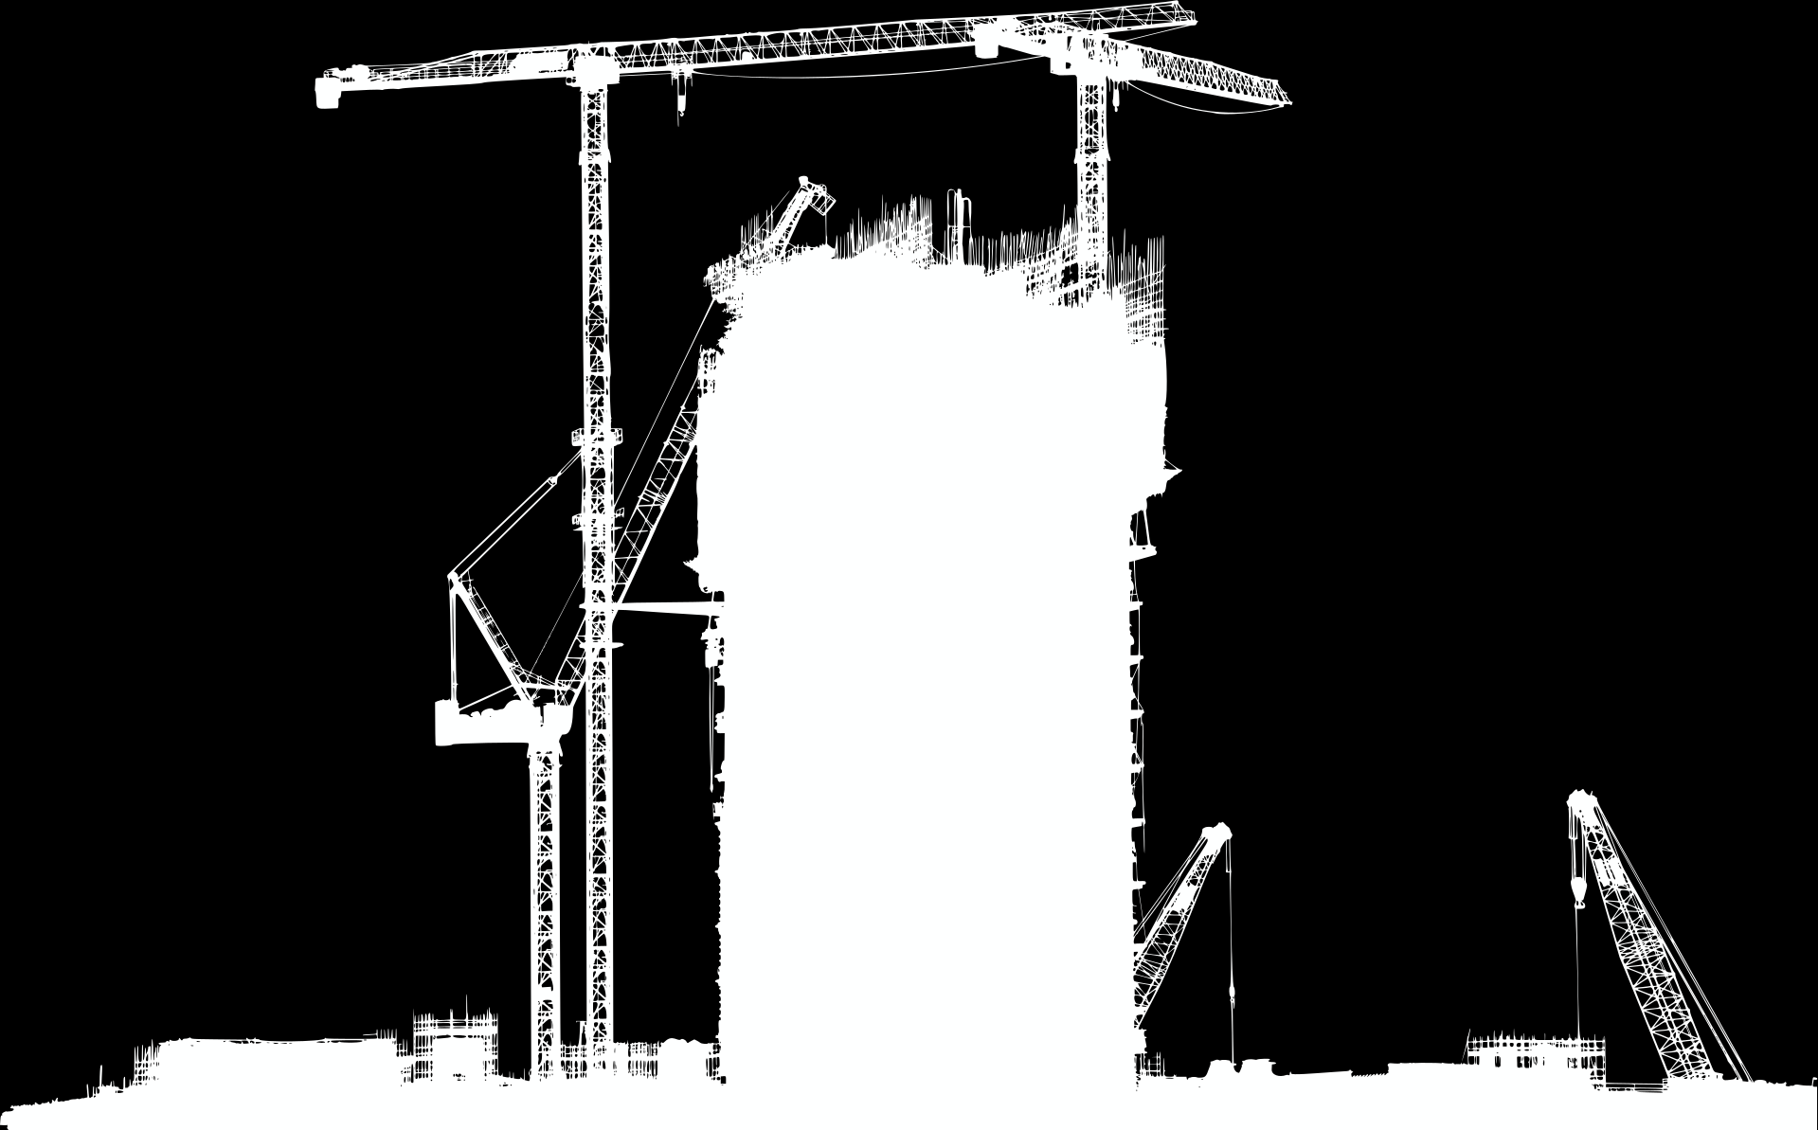
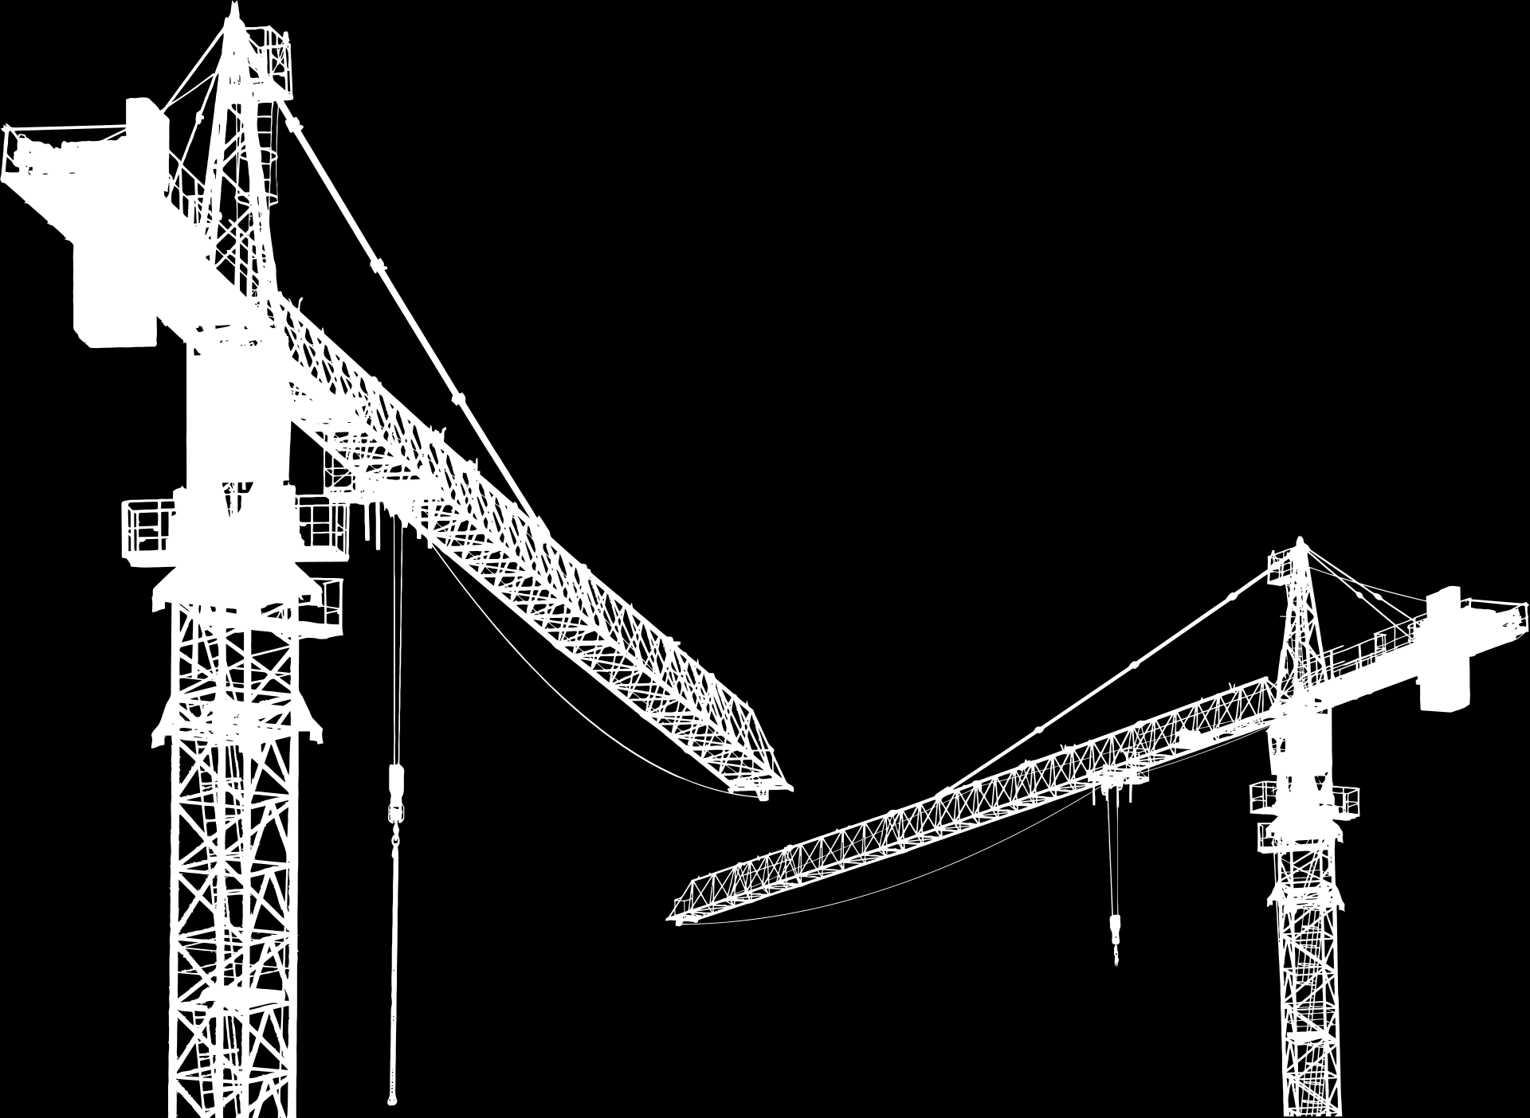
DATA CLEANING
To ensure our data was accurate and usable, we performed several cleaning steps:
Removed Duplicates: Eliminated repeated listings.
Handled Missing Values: Filled or removed missing data points.
Standardized Formats: Ensured consistency in data formats (e.g., price, area units).
Filtered Outliers: Excluded data points that were unusually high or low.
These steps improved the quality of our dataset for better prediction accuracy.

Slide 5
DATA CLEANING
Treating Null Values :
Facing column : having 7603 null values
Bathroom count : having 43 null values
Amenities : having 32 null values
Treating Outliers :
Square Feet : having 421 outliers
Price : having 831 outliers
Deposit Status : having 673 outliers

Slide 6
DATA CLEANING
Converting text values column to numerical :
Before Using Machine learning algorithm it is necessary to treat categorical columns.
BHK Apartment, Bathroom Count, Location,Furnish Status
These columns having text data.
Also These columns following some orders (hierarchy) so i use
ordinal encoding for treating these columns.
for Amenities column i use Count Vectorisor technique

Slide 7
MODEL SELECTION AND APPLICATION
Applying Different Models
We tested various machine learning models to predict rental prices, including:
Linear Regression
Decision Trees
Random Forest
Support Vector Machine
XGBoost Regressor
By comparing these models, we identified the most effective approach for accurate rental price prediction.

Slide 8
XGBOOST REGRESSOR
XGBoost (eXtreme Gradient Boosting) is an optimized gradient boosting library designed to be highly efficient, flexible, and portable. It implements machine learning algorithms under the Gradient Boosting framework. XGBoost regressor is a specific implementation used for regression tasks. Here are some key points about the XGBoost regressor:

Slide 9
WEB APPLICATION
To make the rental price prediction model accessible to everyone, I converted it into a Flask web application. This allows users to input property details and get predicted rental prices through a user-friendly interface.

Slide 10

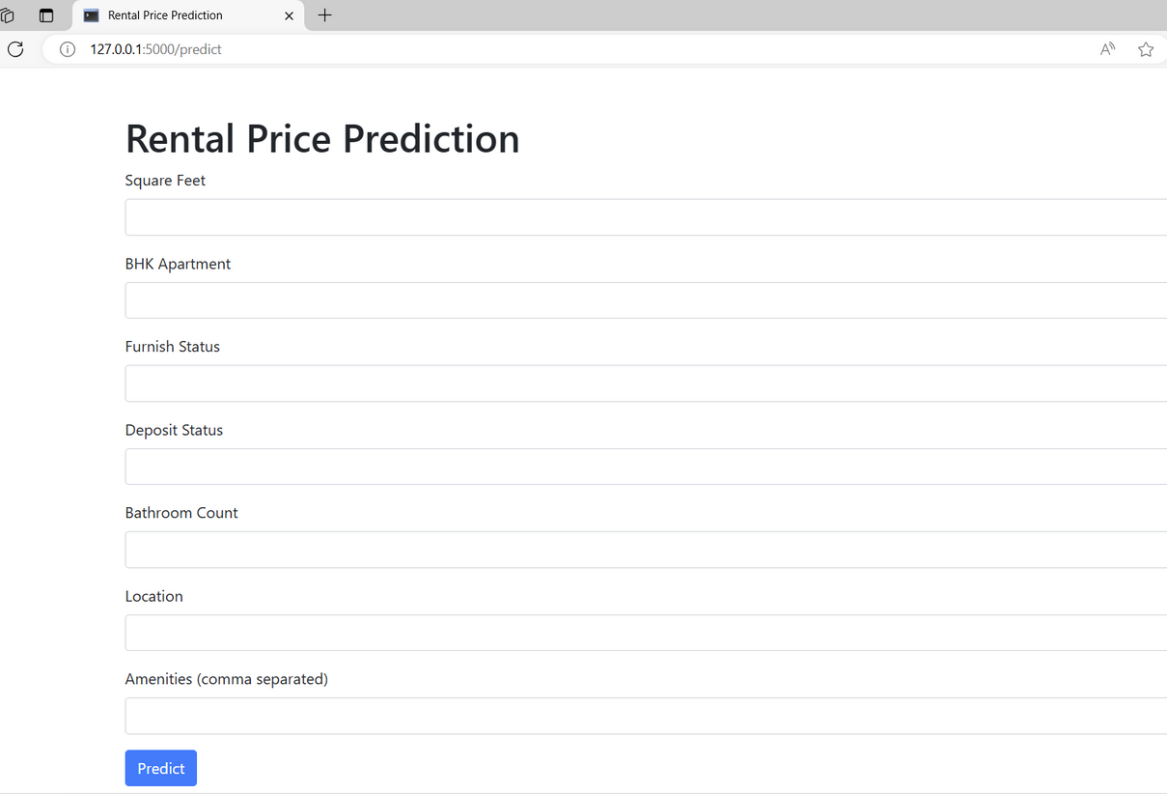
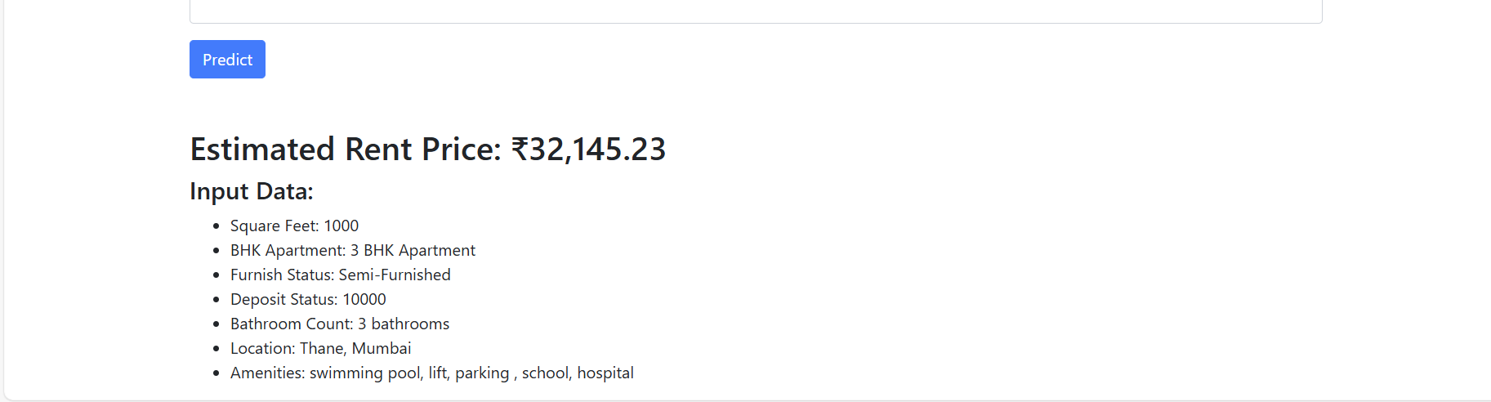
WEB APPLICATION

Slide 11
CONCLUSION
so, our model simplifies the complex rental market in mumbai by providing estimate rental price. This helps both tenants and landlords make better decisions

Slide 12
Thank You

